Slide 1


BREAD CANCER PRREDICTION USING MACHINE LEARNING

Slide 2
THIRUMALAI ENGINEERING COLLEGE DEPARTMENT OF INFORMATION TECHNOLOGY Project team members YAMUNA S (513220204009) ANITHA R (513220205301) KIRUTHIKA S (513220205310) COORDINATER MRS.S.VENMAL M.TECH.,

Slide 3
INTRODUCTION
Machine learning is branch of data science which incorporates a large set of statistical techniques.
These techniques enable data scientists to create a model which can learn from past data and detect patterns from massive, noisy and complex data sets.
Researchers use machine learning for cancer prediction and prognosis. Machine learning allows inferences or decisions that otherwise cannot be made using conventional statistical methodologies.
With a robustly validated machine learning model, chances of right diagnosis improve. It specially helps in interpretation of results for borderline cases.

Slide 4
ABSTRACTION
The most common cancer in women worldwide.
The principle cause of death from cancer among women globally.
Early detection is the most effective way to reduce breast cancer deaths.
Early diagnosis requires an accurate and reliable procedure to distinguish between benign breast tumors from malignant ones
Breast cancer types - three types of breast tumors: benign breast tumors, in-situ cancers, and invasive cancers.
The majority of breast tumors detected by mammography are benign.
This analysis assists in differentiating between benign and malignant tumors.

Slide 5
EXISTING SYSTEM
Mammography is an important tool for detecting breast cancer in its earliest stages. Since mammography is ineffective for women with dense breast tissue, diagnostic ultrasound is often used instead.
This system is intended to improve breast cancer prediction through the use of machine learning analytics.
The proposed mlisbcp system performs pre-processing on the breast cancer data,
To manage missing values, encode features, handle class imbalance or perform oversampling, and perform feature selection.

Slide 6
PROPOSED SYSTEM
The suggested method uses a trained deep learning neural network system to categorize breast cancer subtypes. According to data from 221 actual patients, the findings have an accuracy of 90.50 percent. Without needing any human intervention, this model can classify and identify breast cancer lesions.
In this paper, six categorization models (RF, DT, KNN, LR, SVC, linear SVC) are applied for breast cancer diagnosis.
The preprocessing phase involves replacing duplicate values, balancing data, and performing feature extraction before splitting the data into training and testing sets.
Performance evaluation is conducted using a confusion matrix, analyzing metrics like accuracy, precision, recall, sensitivity, and f1-score to gauge the effectiveness of the ML.

Slide 7
SCOPE
Identify breast cancer early and define its type by analyzing tumor size.
To make the computers smarter, more intelligent.
This model can classify and identify breast cancer lesions.
Real time monitoring system

Slide 8
DATASET
A dataset is a collection of data points used to train, validate, or test a machine learning model. It consists of a set of examples, where each example typically represents an individual observation or sample.
This dataset contains features computed from a digitized image of a fine needle aspirate (fna) of a breast mass. These features describe characteristics of cell nuclei present in the image. The task associated with this dataset is to predict whether a tumor is benign (non-cancerous) or malignant (cancerous) based on these features.
The tests were performed on a dataset consisting of 317,880 clinical observations. The proposed model achieved an accuracy of 91.22%, and a false rejection rate of 112%.

Slide 9
SYSTEM REQUIREMENTS
Hardware Requirements
1.Minimum RAM: -4GB
2.Hard disk: -128 GB
3.Processor: -intel pentium 5 or higher.
Software Requirement
1. OS: windows
2. Python IDE: python 2.7.X and above
3.Jupyter notebook
4.Visual studio code
5. Language: python

Slide 10
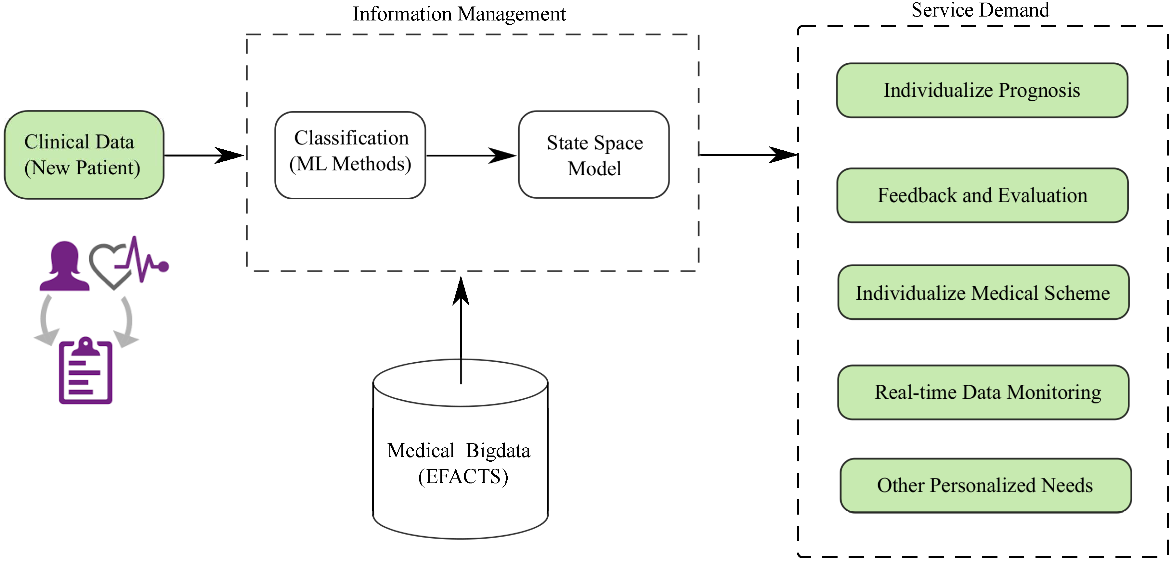
ARCHITECTURE DIAGRAM

Slide 11
DATA FRAMES
It is the crucial components in Bread cancer prediction in data analysis project.
They help organize and manipulate data efficiency.
Python library packages like numpy, pandas are used for this purpose.
Data frames accepts many different kinds of inputs.

Slide 12
MODULES
Module 1 :CLEANING THE DATA SET.
Module 2 : Collect raw data.
Module 3 : Import the libraries (pandas, numpy, sklearn
etc.,).
Module 4 : process the data for analysis.(explore the
data).
Module 5 : COMPUTING THE ACCURACY
Module 6 : communicate results of the analysis.

Slide 13
PACKAGES
Which are being used for data exploration, pro processing and for using random forest algorithm are:
Numpy: for simple arrays.
Pandas: for reading the file.
Scikit: learn- for pre-processing.
Matplotlib or seaborn: for plotting and representing confusion matrix color format.
Tensor flow: for matrix format.

Slide 14
IMPLEMENTATION
Implementing a bread cancer prediction system using machine learning involves several steps. Here's a simplified outline of how you could approach it:
Data collection: obtain a dataset containing information about breast cancer cases.
Data preprocessing: clean the data by handling missing values, dealing with outliers, and performing feature scaling.
Exploratory data analysis (eda): explore the dataset to gain insights into the relationships between variables.
Model selection: choose appropriate machine learning algorithms for classification tasks.

Slide 15
FUTURE ENHANCEMENTS
For future enhancements in breast cancer classification using machine learning, consider the following avenues for improvement
Advanced feature engineering: explore more sophisticated feature engineering techniques, including feature selection methods like recursive feature elimination, principal component analysis (PCA), or autoencoders to extract meaningful representations from the data.
Ensemble methods: experiment with ensemble learning techniques such as bagging, boosting, or stacking to combine multiple models' predictions, potentially improving overall classification performance and robustness.
Robustness and fairness: ensure that the model is robust to variations in data distributions and demographics by evaluating its performance across different subpopulations.

Slide 16
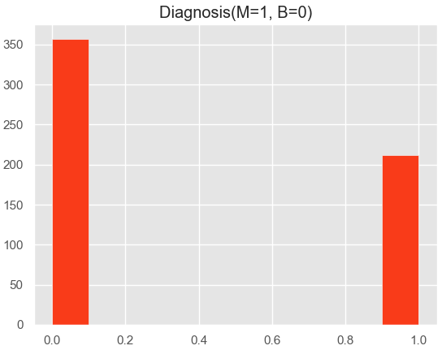
output

Slide 17
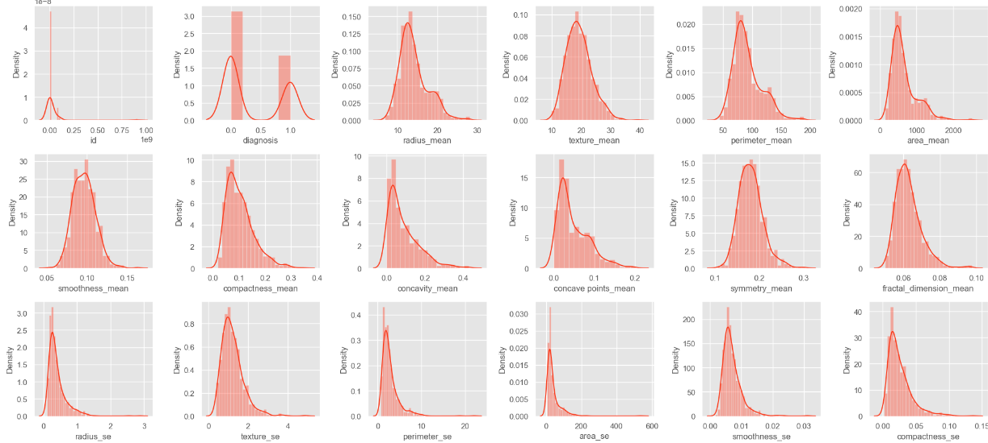
Data preprocessing

Slide 18
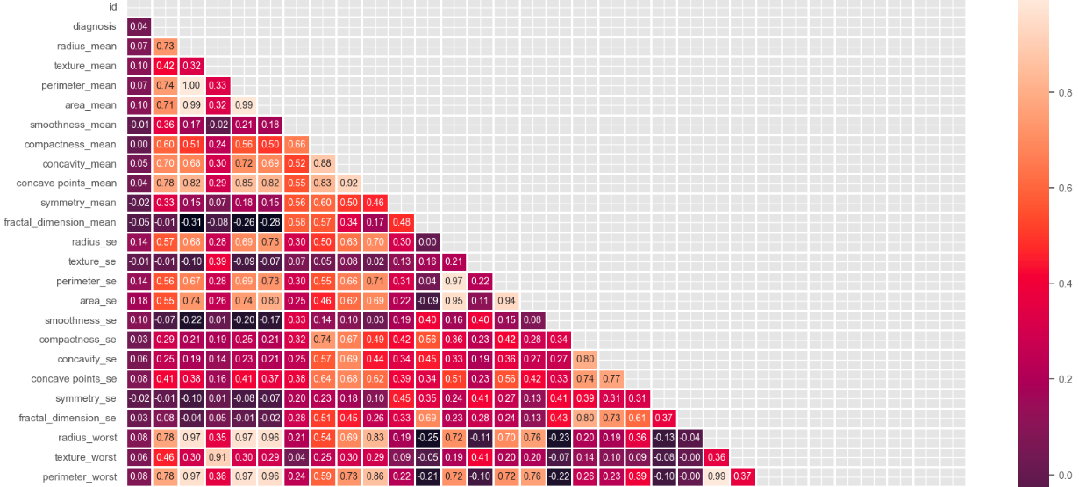
Heat map

Slide 19
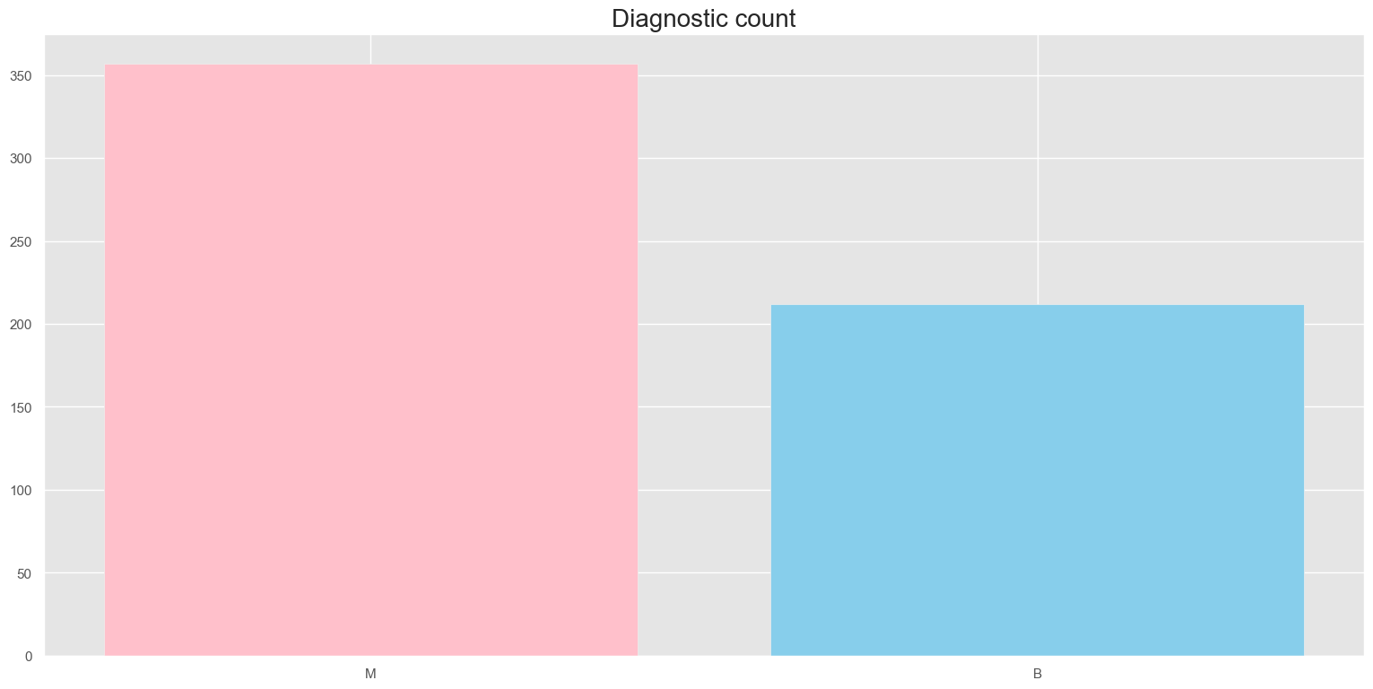
DIAGNOSIS COUNT IN BREAD Cancer prediction

Slide 20
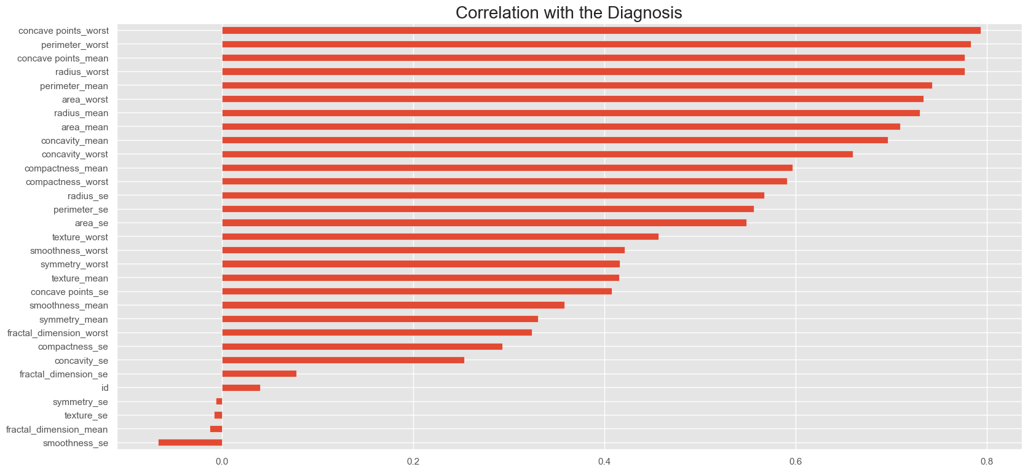
CORRELATION DIAGNOSIS

Slide 21
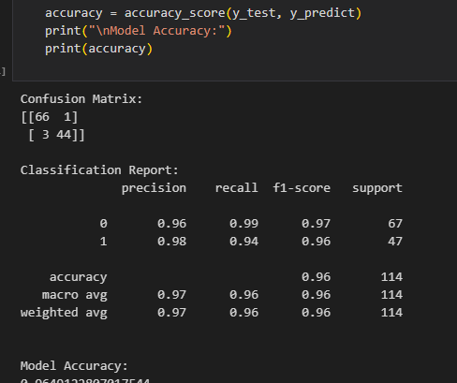
ACCURACY

Slide 22
CONCLUSION
In conclusion, breast cancer prediction using machine learning (ML) holds significant promise for improving early detection, prognosis, and treatment planning.
By integrating predictive models into clinical practice, healthcare providers can prioritize high-risk patients for further evaluation and intervention, ultimately improving patient outcomes and survival rates.
We can develop more effective tools for early detection, diagnosis, and treatment of breast cancer, ultimately saving lives and improving patient outcomes.

Slide 23
REFERENCES
1."Deep learning for breast cancer diagnosis from mammograms: A perspective" reference: kooi, thijs, et al. "Large scale deep learning for computer aided detection of mammographic lesions." Medical image analysis 35 (2017): 303-312. Link: https://www.Sciencedirect.Com/science/article/pii/S1361841516301839
2."Breast cancer detection and diagnosis using machine learning techniques: A review" reference: jalalian, aliasghar, and mohsen mashohor. "Breast cancer detection and diagnosis using mammographic data: systematic review." Journal of digital imaging 30.5 (2017): 487-496. Link: https://link.Springer.Com/article/10.1007/s10278-017-9960-0
3."A review of machine learning methods for breast cancer prediction and diagnosis" reference: januário, guilherme, et al. "A review of machine learning methods for breast cancer prediction and diagnosis." Frontiers in physiology 11 (2020): 552. Link: https://www.Frontiersin.Org/articles/10.3389/fphys.2020.00552/full
4."Machine learning models in breast cancer survival prediction" reference: słowiński, piotr, and michał słowińska. "Application of machine learning models in breast cancer survival prediction." Technology and health care 26.S2 (2018): 895-902. Link: https://content.Iospress.Com/articles/technology-and-health-care/thc190392
5."Breast cancer prediction using machine learning algorithms: A review" reference: soni, sumit, and satish kumar. "Breast cancer prediction using machine learning algorithms: A review." International journal of computer applications 174.10 (2017): 7-11. Link: https://www.Ijcaonline.Org/archives/volume174/number10/soni-2017-ijca-916527.Pdf

Slide 24


